Slide 1
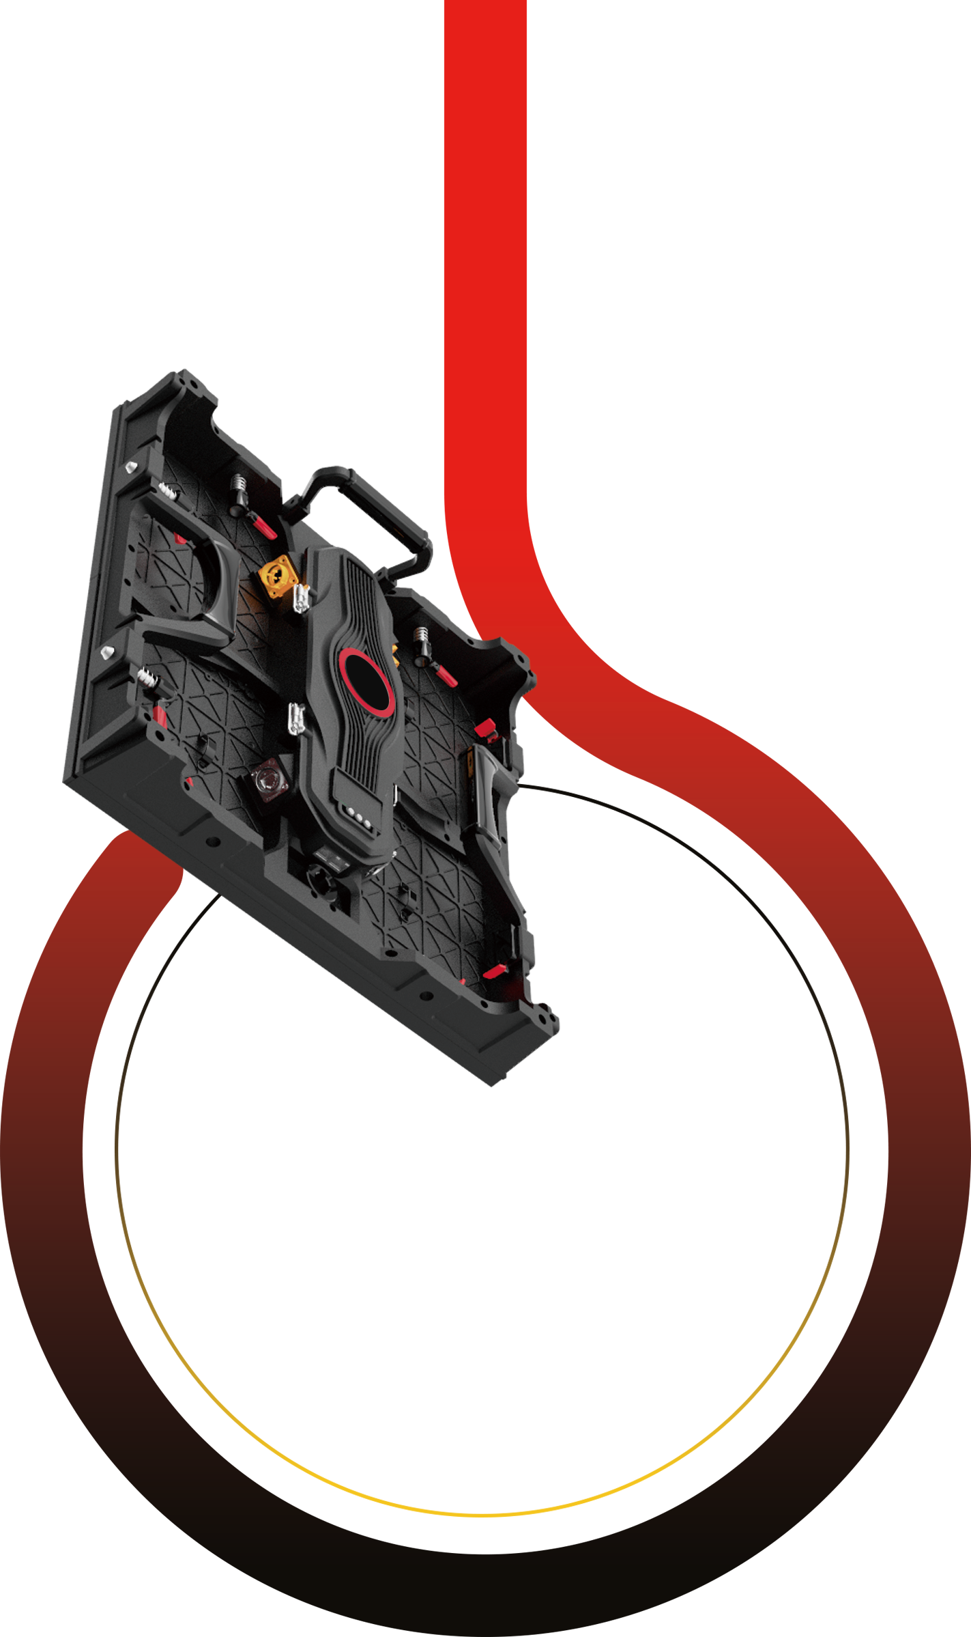
Product Catalogue
GIO Series

Slide 2
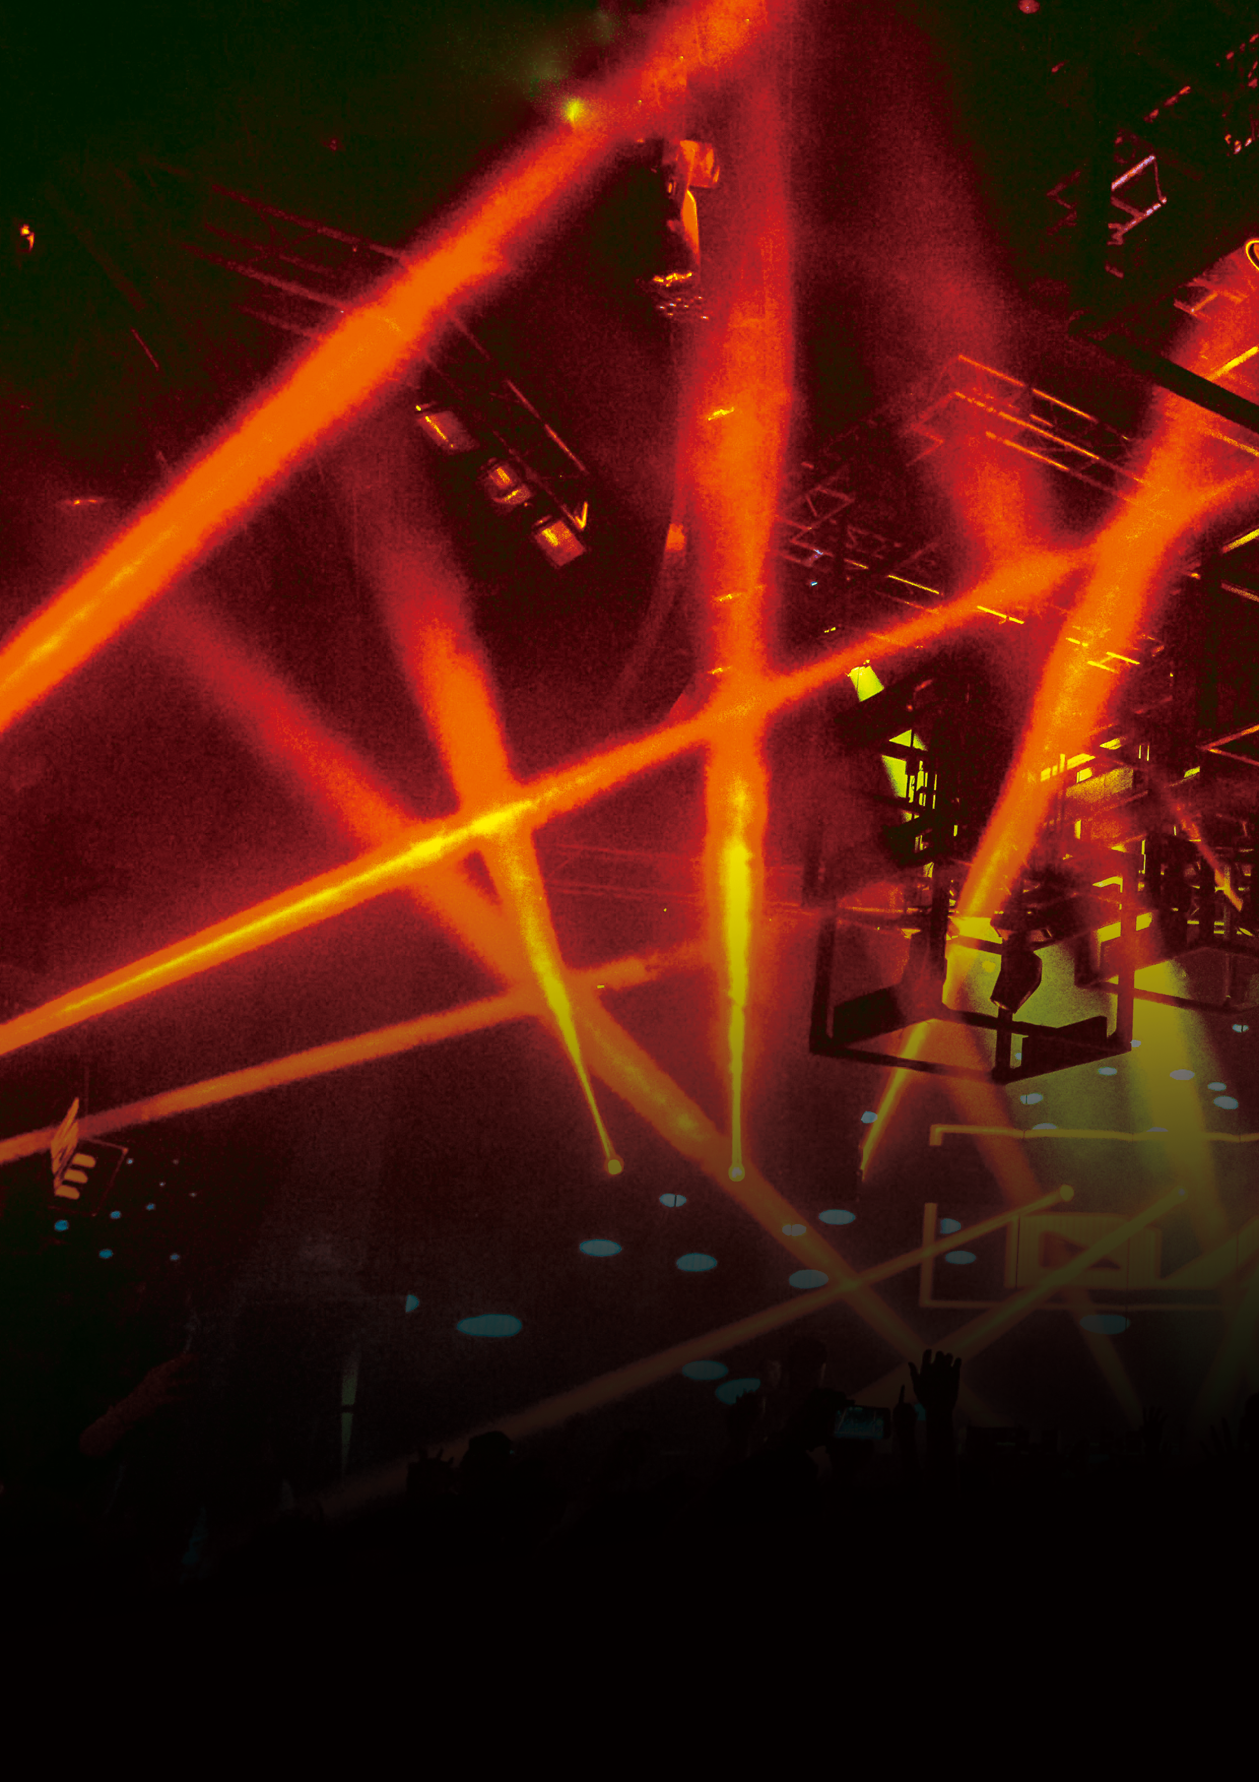
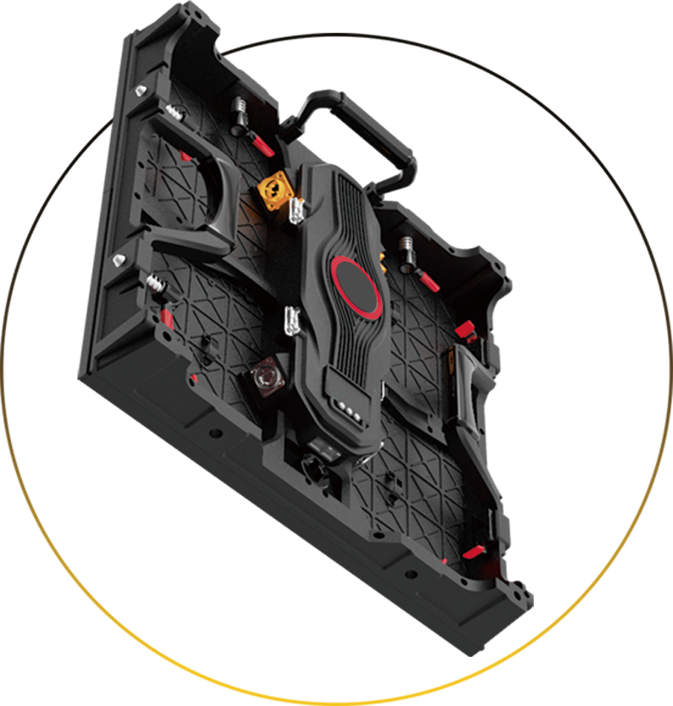
G10 Series
500x500mm
500x1000mm
Technical parameter* T = Outdoor
Model
LED Type
Pixel Pitch (mm)
Pixel Density (dots/m) Module Size (mm) Module Resolution (dots)
Cabinet Size (mm)
Cabinet Weight (KGs) Refresh Rate (HZ) Brightness (CD/m) Average Power (W/m) Driving Method
Viewing Angles (H/V) IP rate
Working Humidity (RH) Working Temperature (°C)
Model
LED Type
Pixel Pitch (mm)
Pixel Density (dots/m) Module Size (mm) Module Resolution (dots)
Cabinet Size (mm)
Cabinet Weight (KGs) Refresh Rate (HZ) Brightness (CD/m) Average Power (W/m) Driving Method
Viewing Angles (H/V) IP rate
Working Humidity (RH) Working Temperature (°C)
P2.6 | P2.97 | P3.91 | P2.97T | P3.91T | P4.81T
SMD1515 | SMD1515 | SMD2121 | SMD1415 | SMD1921 | SMD1921/SMD2525 can choose
2,6 | 2,976 | 3,906 | 2,976 | 3,906 | 4,807
147,456 | 112,896 | 65,536 | 112,896 | 65,536 | 43,264
250*250 | 250*250 | 250*250 | 250*250 | 250*250 | 250*250
96*96 | 84*84 | 64*64 | 84*84 | 64*64 | 52*52
"500*500*85 / | "500*500*85 / | "500*500*85 / | "500*500*85/ | ^{fl}500*500*85 / | ^{n}500*500*85 /
500*1000*85" | 500*1000*85" | 500*1000*85” | 500*1000*85^{H} | 500*1000*85" | 500*1000*85“
8.5/13.2 | 8.5/13.2 | 8.5/13.2 | 8.5/13.2 | 8.6/13.6 | 8.6/13.6
3840 | 7680 | 7680 | 7680 | 7680 | 7680
800-1200 | 1000-2000 | 1000-2000 | 4000-4500 | 4500-5000 | 3500-4000
250 | 250 | 250 | 300 | 300 | 300
l/32s | l/28s | l/16s | 1/21S | 1/16S | 1/13S
1607160° | 1607160° | 160°/160° | 1607160° | 160°/160° | 160°/160°
IP30 | IP30 | IP30 | IP65 | IP65 | IP65
 | 10%-60% |  |  | 10%-90%
-40°C ~ +80°C
Installation Types
-40°C ~ +80°C
Installation Types
Sitting/Floor/Lifting/Arc/Special-shaped/Right Angle
Sitting/Floor/Lifting/Arc/Special-shaped/Right Angle
G10
HARDWIRED DESIGN
Independent control box
+ hot plug and play
ALL ENVIRONMENT
Indoor/outdoor/floor/curved allowed
CURRENT-SHARING FOR POWER BACKUP
No black screen phenomenon when power
interrupted + signal backup
G10 series products include indoor and outdoor applications. Under the criterion of fast installation, its control box, HUB board, receiving card and modules are all used hardwired connection for quick removed and plug-in. It features with all rental led display's necessary processes including full-viewing mask, current-sharing for power backup, anti-collision PCB board and so on.
Brand-new G10 series is rocked dazzling...
Size： 500x500mm Size： 500x1000mm

Slide 3
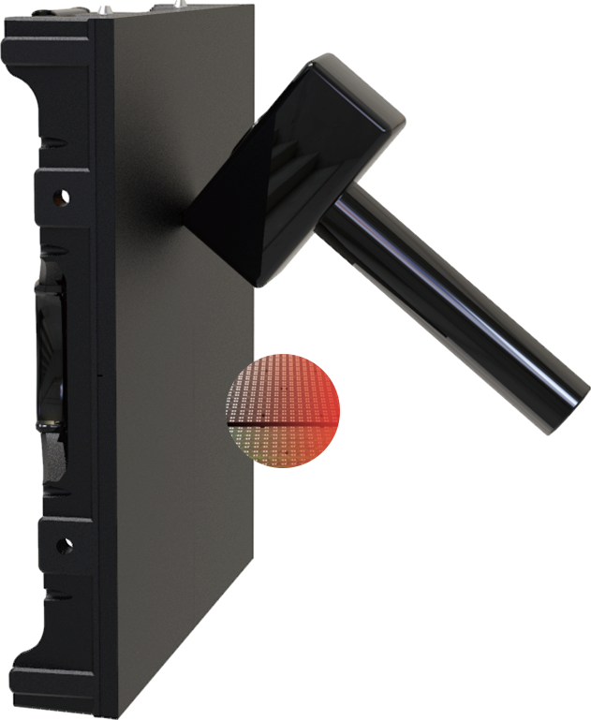
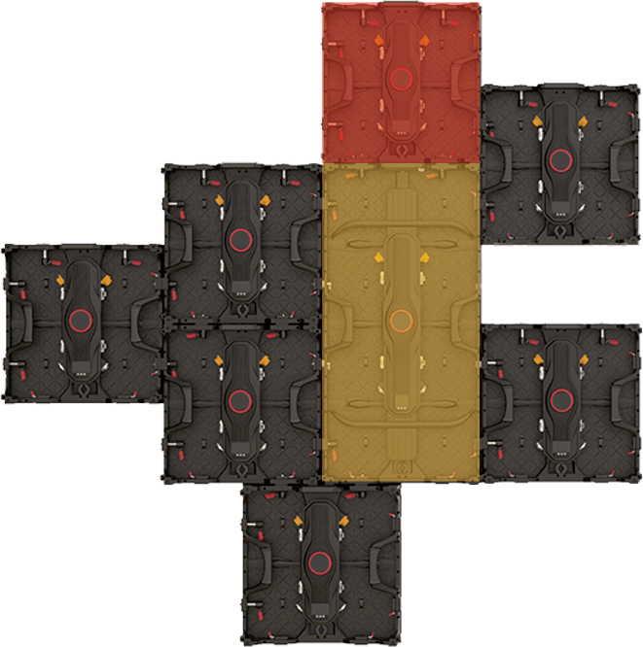
GIO Series
Start from the precise design of rental application
The entire G10 series are dedicated to solve the problems of instant installation, easy maintenance and anti-collision for rental applications
LATEST TECHNOLOGY OF ANTI-COLLISION
PCB anti-collision welding plate
4 groups of data transmission are adopted
THE DESIGN OF G10 SERIES SPLICING WITH EACH OTHER
500*500mm & 500*1000mm cabinets can either splicing with each other, or dislocated splicing for more creative displaying

Slide 4
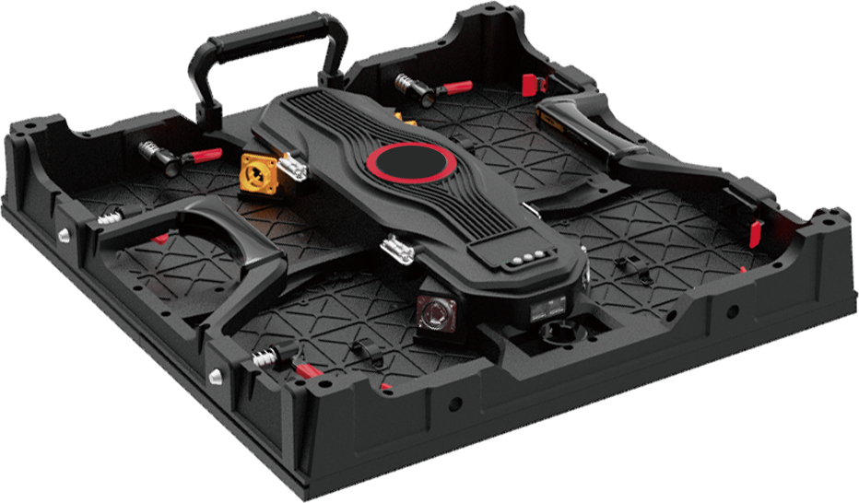
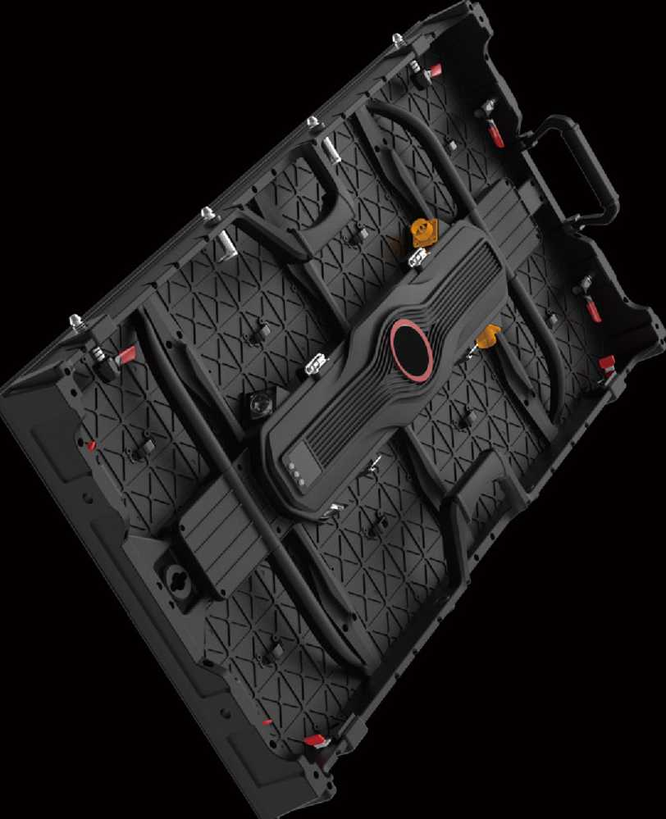
GIO Series
Start from the precise design of rental application
The entire G10 series are dedicated to solve the problems of instant installation, easy maintenance and anti-collision for rental applications
Continuous Signal
Signal backup by two network ports to assure activity easily
NEVER WORRYING ABOUT SCREEN IN BLACK WITH POWER BACKUP DESIGN
500*1000mm compatible design,
more flexible scheme

Slide 5
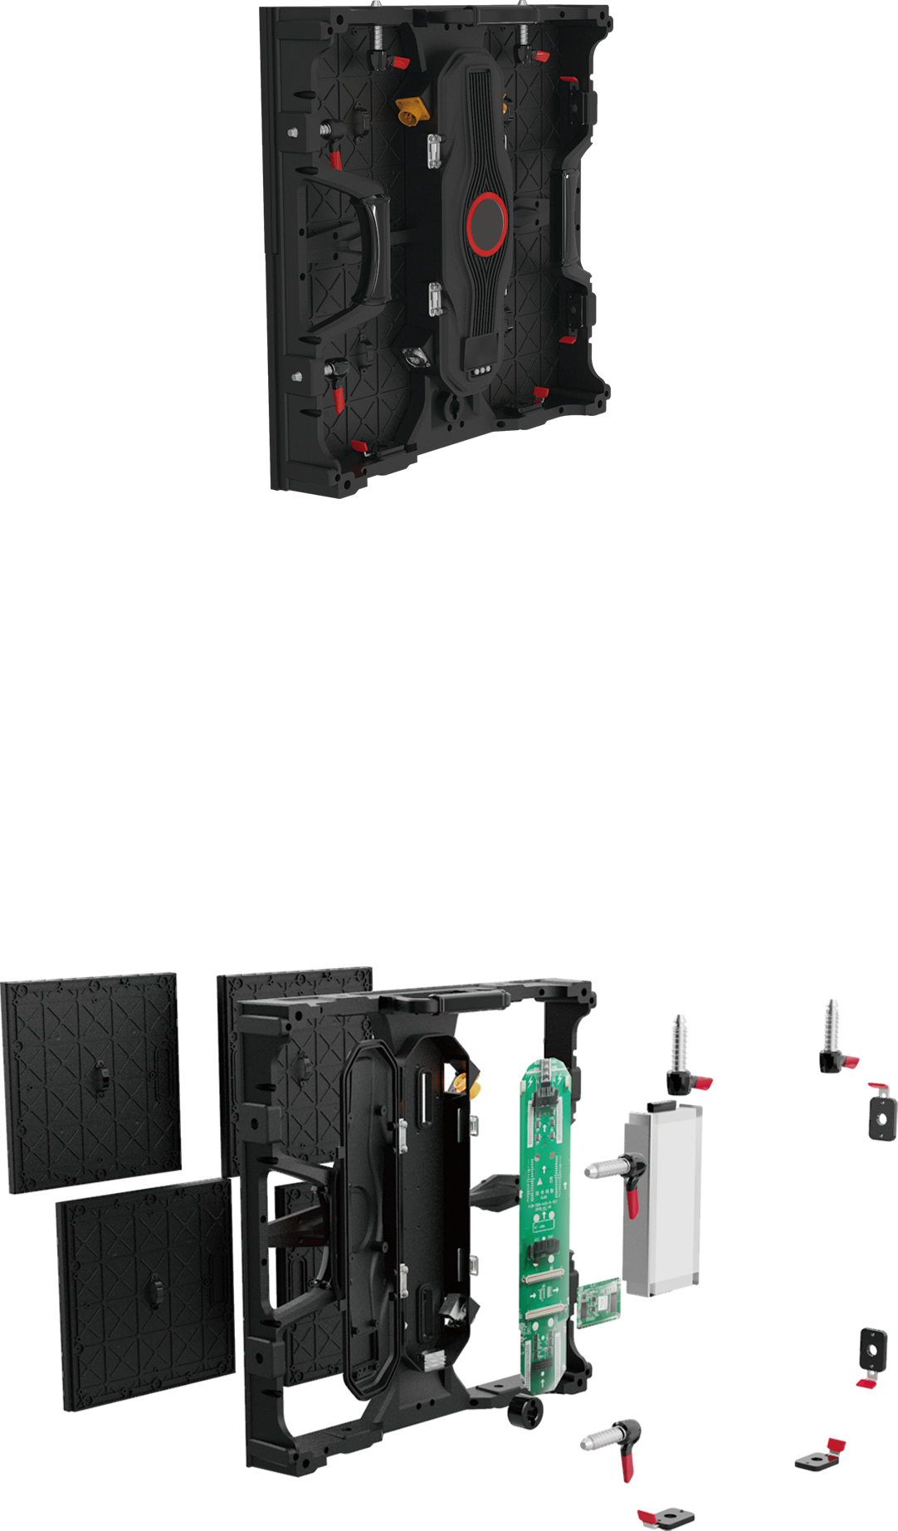
GIO Series
Start from the precise design of rental application
The entire G10 series are dedicated to solve the problems of instant installation, easy maintenance and anti-collision for rental applications
Fast lock
Folding handle
Module handle
Power port
Brand LOGO
Horizontal handle
Lock for rear cover
Signal port
Signal indicator
Locking hole for installation structure
CAT signal port
--------------------------------------------------INTEGRATED MODULAR DESIGN-------------------------------------------------------
Module
Die casting aluminum
Plug type power supply
AXS receiving card
HUB board

Slide 6
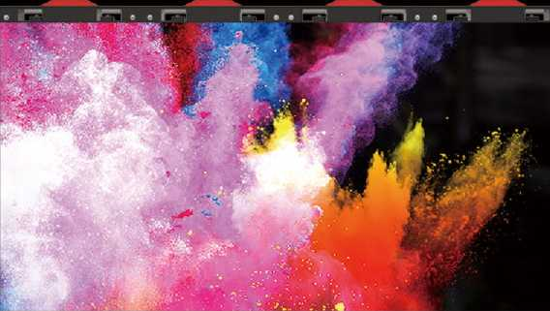
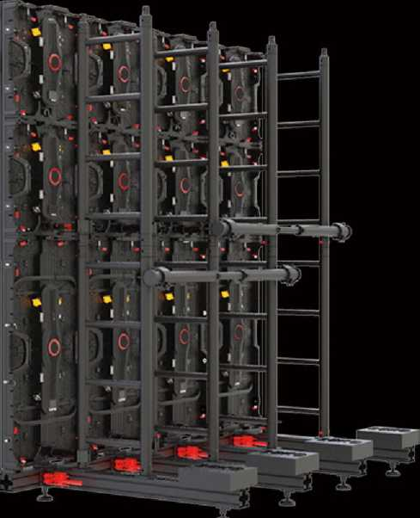
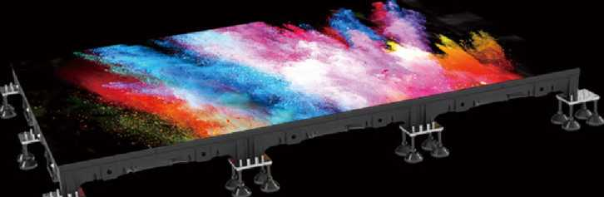
GIO Series
Start from the precise design of rental application
The entire G10 series are dedicated to solve the problems of instant installation, easy maintenance and anti-collision for rental applications
OVERVIEW OF INSTALLATION MODE
Hanging to install
I (max height <10m)
OVERVIEW OF INSTALLATION MODE
Stacking to install
I (max height <10m)
OVERVIEW OF INSTALLATION MODE
Installed as floor
I Use fixed fittings

Slide 7
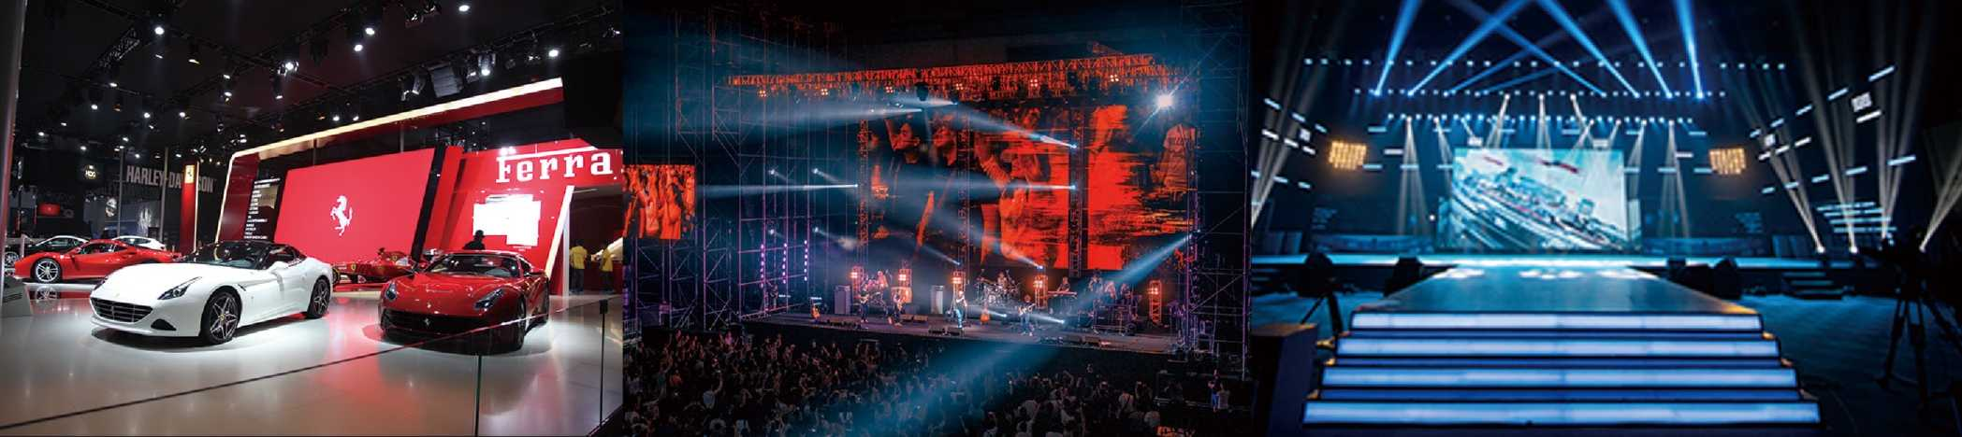
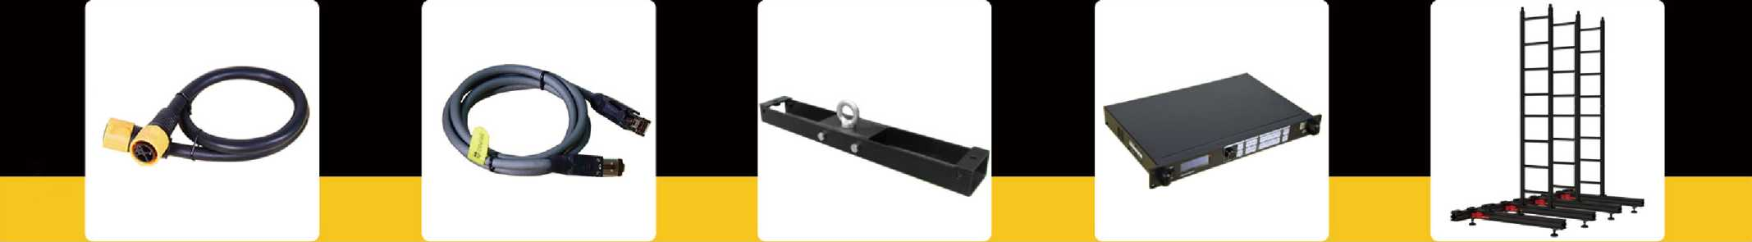
GIO Series
Start from the precise design of rental application
The entire G10 series are dedicated to solve the problems of instant installation, easy maintenance and anti-collision for rental applications
Indoor
Outdoor
Floor
PRODUCT ACCESSORIES
The sign with * is the optional accessories
Power cable
Signal cable
Hanging beam* Video processor* Back rack*

